Slide 1

Bootstrapping
ADS2, Lecture 2.14
Dr Rob Young – robert.young@ed.ac.uk
Semester 2, 2023/24

Slide 2
We’ve talked a lot about assumptions in ADS2…
T-tests
Correlation and regression
Categorical data
ANOVA

Slide 3
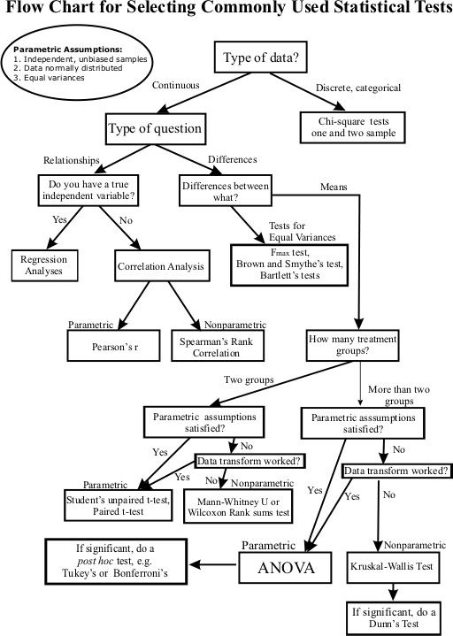
We talk a lot about assumptions in statistics generally…

Slide 4

…but what if your data doesn't fit any of these?!

Slide 5
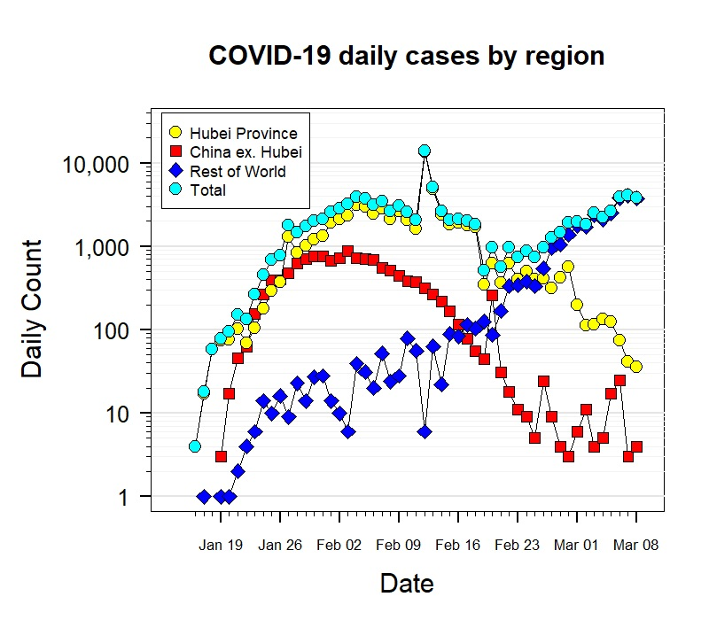
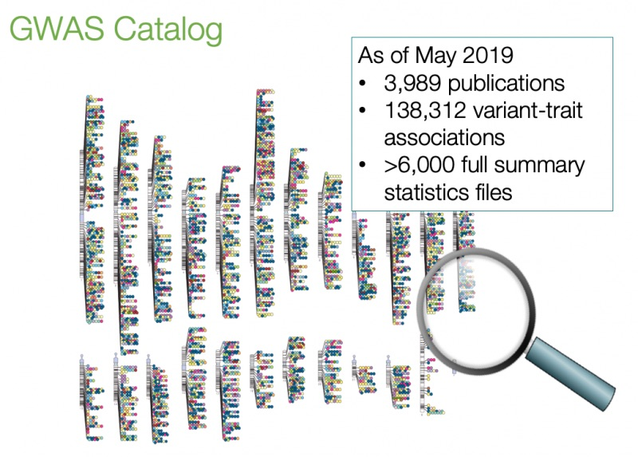
Many biomedical datasets have a complex distribution
Notes:
COVID-19 graph taken from IBI1 6.1 lecture

Slide 6
Learning objectives
After this lecture, you should be able to:
Explain the concept of bootstrapping.
Recognise situations where bootstrapping is useful.

Slide 7
Lecture outline
R function sample
Bootstrapping for hypothesis testing
Bootstrapping to generate confidence intervals
Reflection on bootstrapping

Slide 8
Bonus content: No equations, only a function
Sampling from a set: sample()
e.g. draw 10 samples from your dataset without replacement: sample(dataset, 10, replace=FALSE)
Can you explore this function yourself in R?
What do you think might be the most useful parameters?

Slide 9
Drawing random numbers in R
Sampling from a set: sample(), e.g. draw 10 samples from your dataset with replacement: sample(dataset, 10, replace=FALSE)
If your dataset contains 50 data points, what is the maximal sample size for sampling without replacement? How about with replacement?

Slide 10
Drawing random numbers in R
Sampling from a set: sample(), e.g. draw 10 samples from your dataset with replacement: sample(dataset, 10, replace=FALSE)
If your datasets contains 50 data points, what is the maximal sample size for sampling without replacement? How about with replacement?
Normally distributed random numbers: rnorm(), e.g. draw 100 numbers from a normal distribution with mean 4 and standard deviation 2: rnorm(100,4,2)
What will the histogram look like?
Notes:
A normal distribution, bell curve
Of the type we’ve looked at lots of times before

Slide 11
Drawing random numbers in R
Sampling from a set: sample(), e.g. draw 10 samples from your dataset with replacement: sample(dataset, 10, replace=FALSE)
If your datasets contains 50 data points, what is the maximal sample size for sampling without replacement? How about with replacement?
Normally distributed random numbers: rnorm(), e.g. draw 100 numbers from a normal distribution with mean 4 and standard deviation 2: rnorm(100,4,2)
What will the histogram look like?
Uniformly distributed random numbers: runif(), e.g. draw 100 numbers between 0 and 10: runif(100,0,10)
What will the histogram look like?
Notes:
Flat line, each number should be on average drawn 10 times

Slide 12
Lecture outline
R function sample
Bootstrapping for hypothesis testing
Bootstrapping to generate confidence intervals

Slide 13
Bootstrapping
Problem:
We do not know or fully understand the population distribution.
However:
We have some information about the underlying distribution: the data! We use the data itself as the basis for our randomisation. This is called bootstrapping. We create a bootstrap sample by sampling (with replacement) from the data, and repeat this procedure many times.
Notes:
‘succeed by your own efforts’

Slide 14
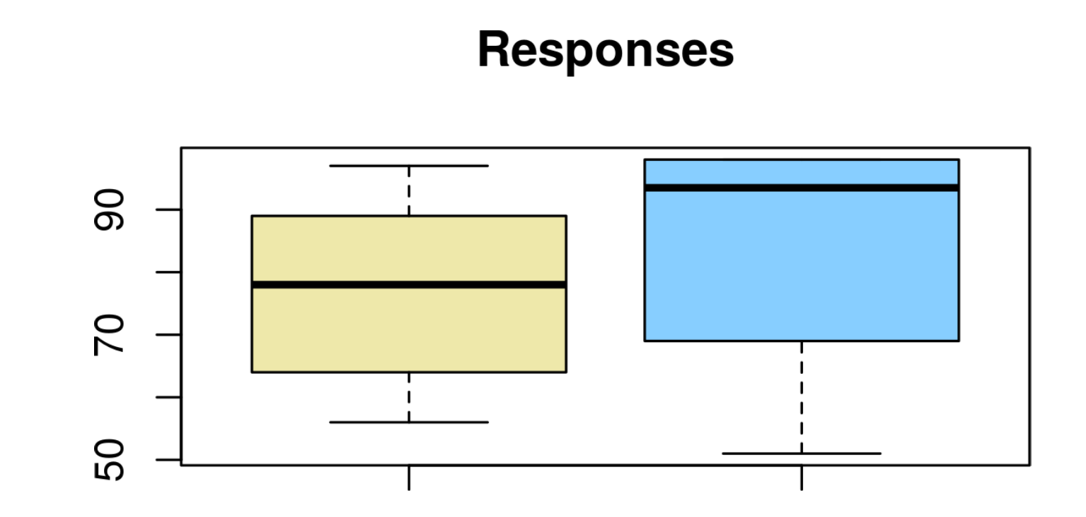
Example: How do groups respond to a drug?
A lab tests response to a cancer drug in two cell lines with different genetic backgrounds. Response is measured as survival rate (in percent) per sample. 10 samples were tested for each condition. Researchers would like to know whether the median response rate differs between both groups. What test would you use?

Slide 15
Example: How do groups respond to a drug?
How would you bootstrap this?
Notes:
Give them a few mins to think about this. They did not see the next set of slides
We create a bootstrap sample by sampling (with replacement) from the data, and repeat this procedure many times.

Slide 16
Example: How do groups respond to a drug?
How would you bootstrap this?
If H₀ is true, then genetic background does not really matter. So, under H_{0,} a given observation (from our sample) could equally well come from group 1 or from group 2.
Pool data from group 1 and group 2.

Slide 17
Example: How do groups respond to a drug?
How would you bootstrap this?
If H₀ is true, then genetic background does not really matter. So, under H_{0,} a given observation (from our sample) could equally well come from group 1 or from group 2.
Pool data from group 1 and group 2.
For each experiment, do the following:
Sample (with replacement) from pool to get bootstrap sample 1.
Sample (with replacement) from pool to get bootstrap sample 2.
Compute difference in median between sample 1 and sample 2.

Slide 18
Example: How do groups respond to a drug?
How would you bootstrap this?
If H₀ is true, then genetic background does not really matter. So, under H_{0,} a given observation (from our sample) could equally well come from group 1 or from group 2.
Pool data from group 1 and group 2.
For each experiment, do the following:
Sample (with replacement) from pool to get bootstrap sample 1.
Sample (with replacement) from pool to get bootstrap sample 2.
Compute difference in median between sample 1 and sample 2.
Do this many times. How often is the difference in median greater than or equal to that observed?
Why do we want to know this?

Slide 19
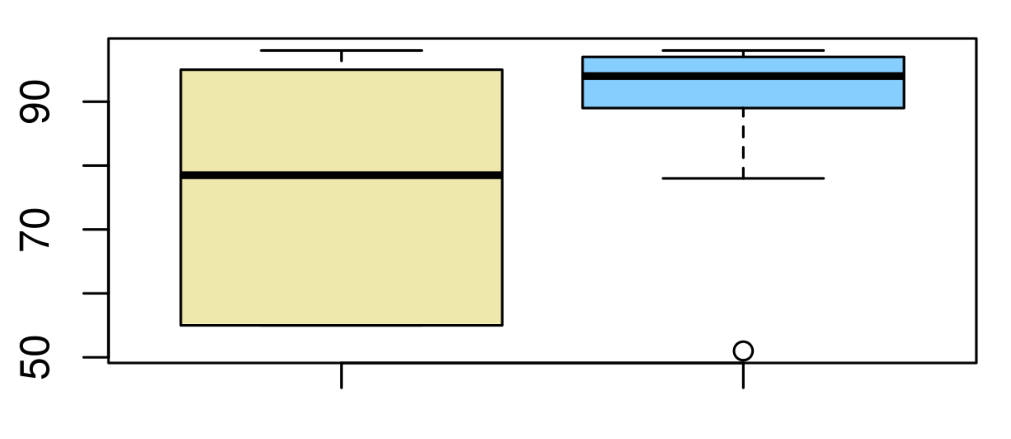
Responses

Slide 20
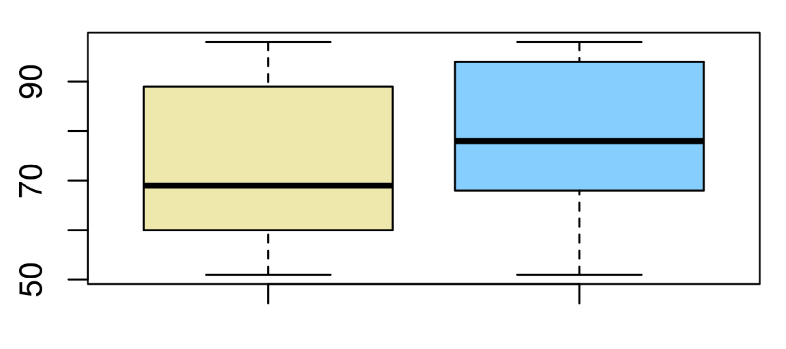
Responses

Slide 21
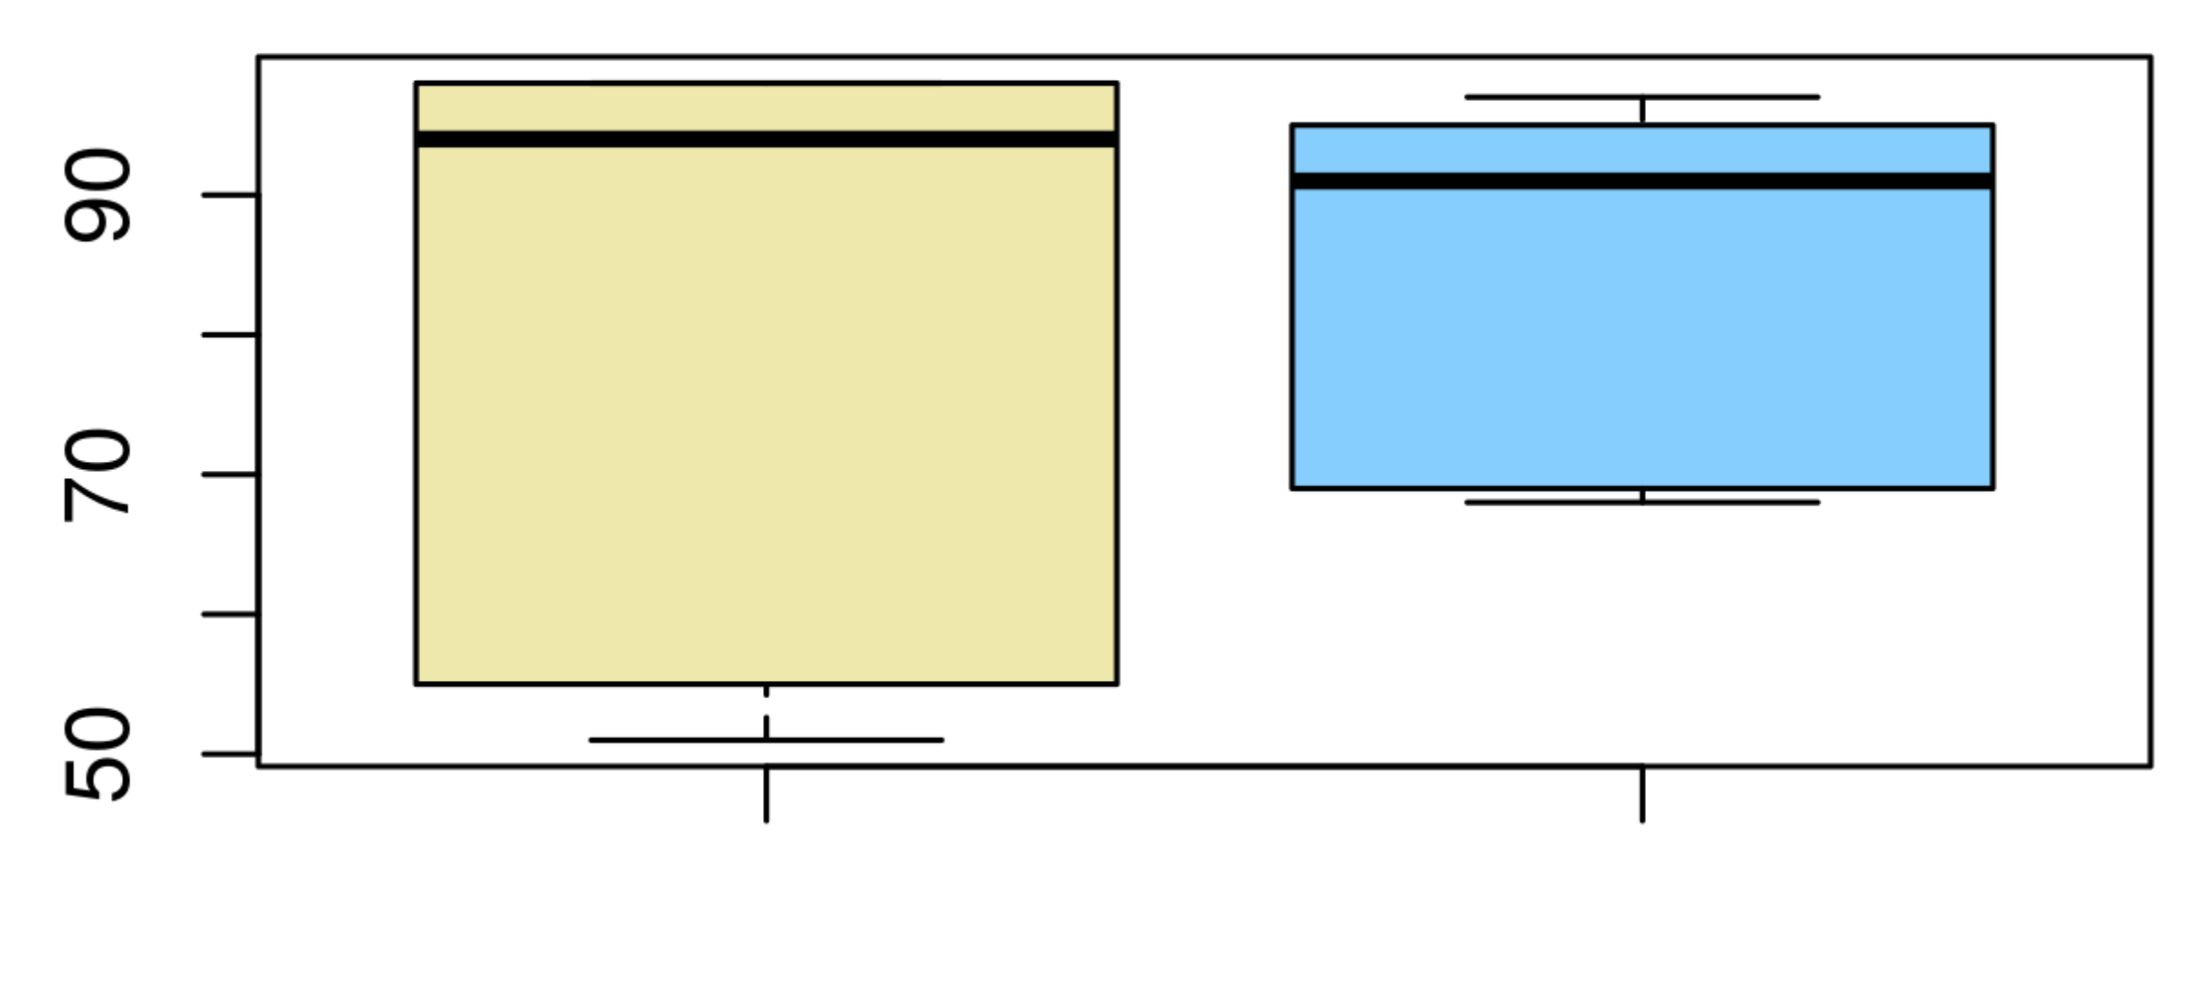
Responses

Slide 22
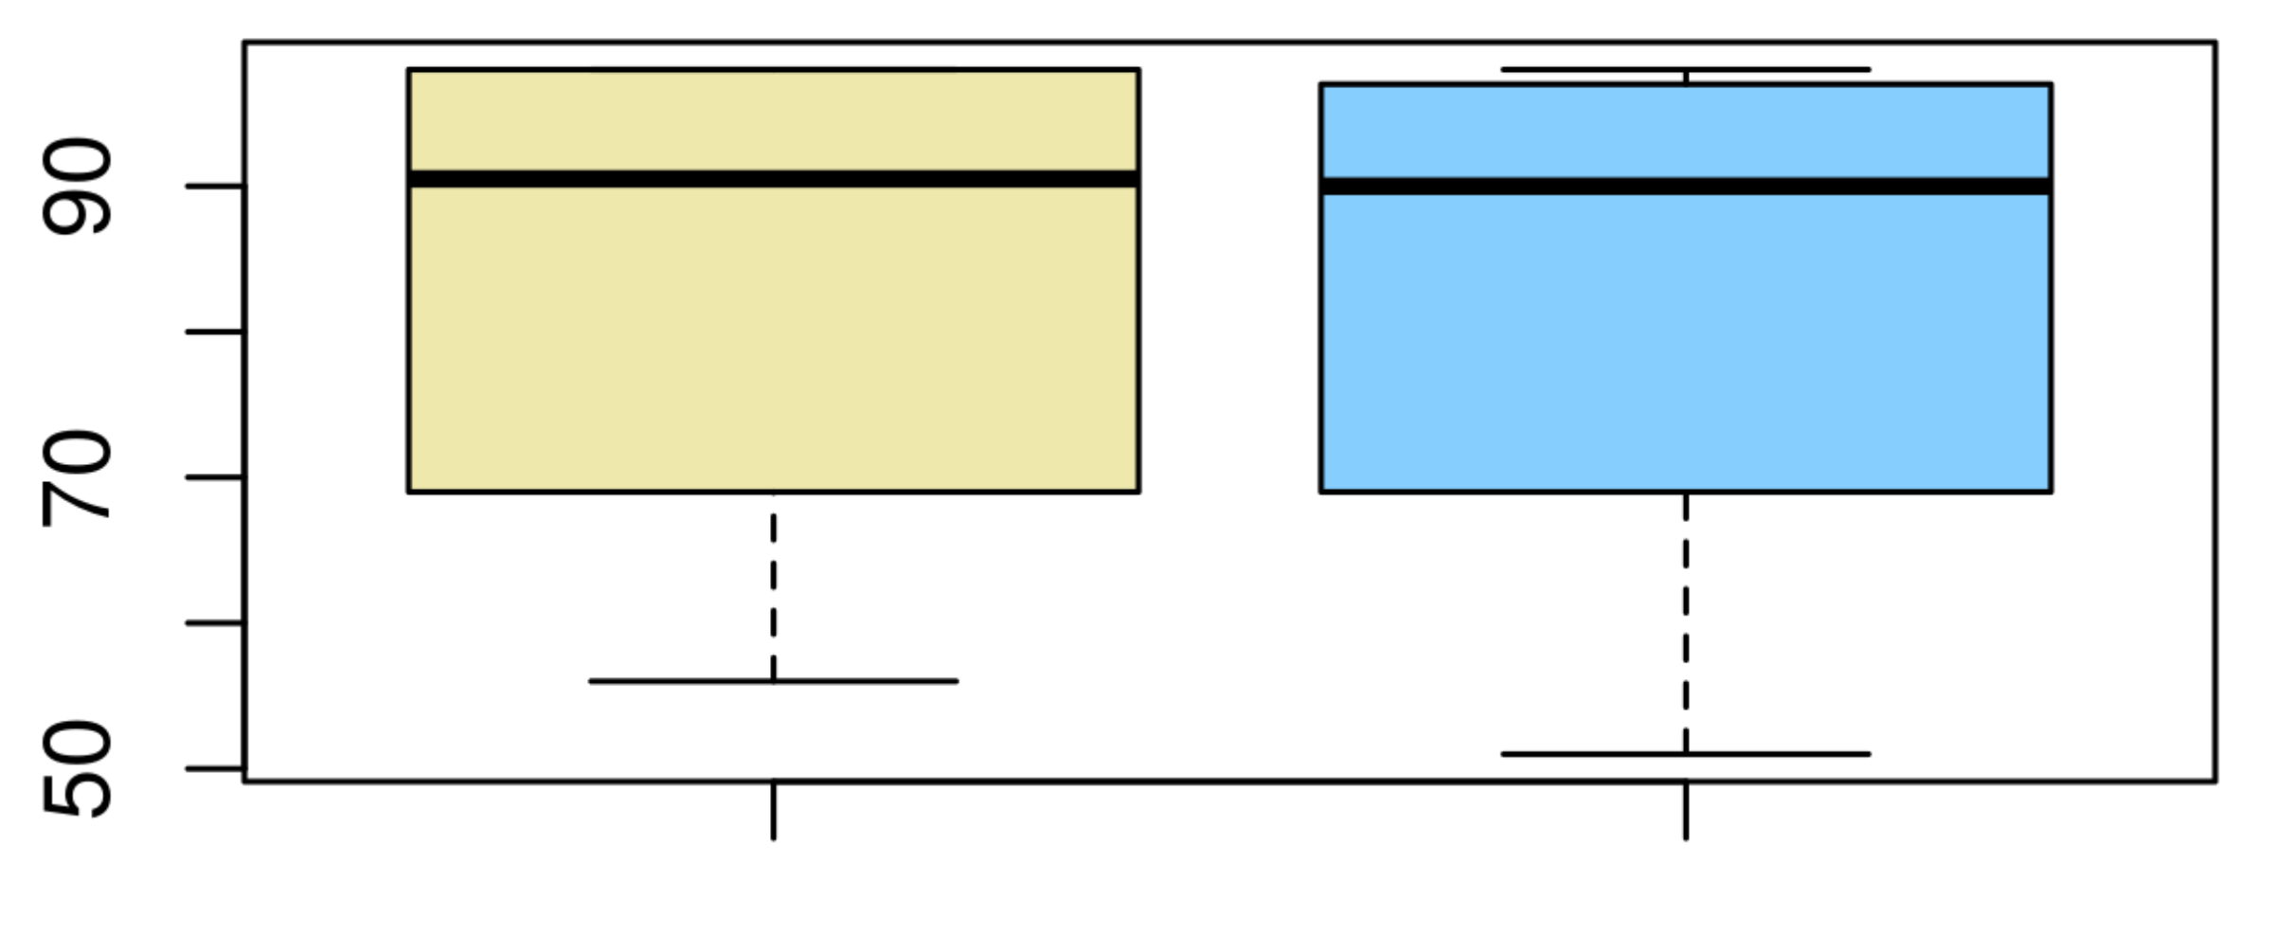
Responses

Slide 23
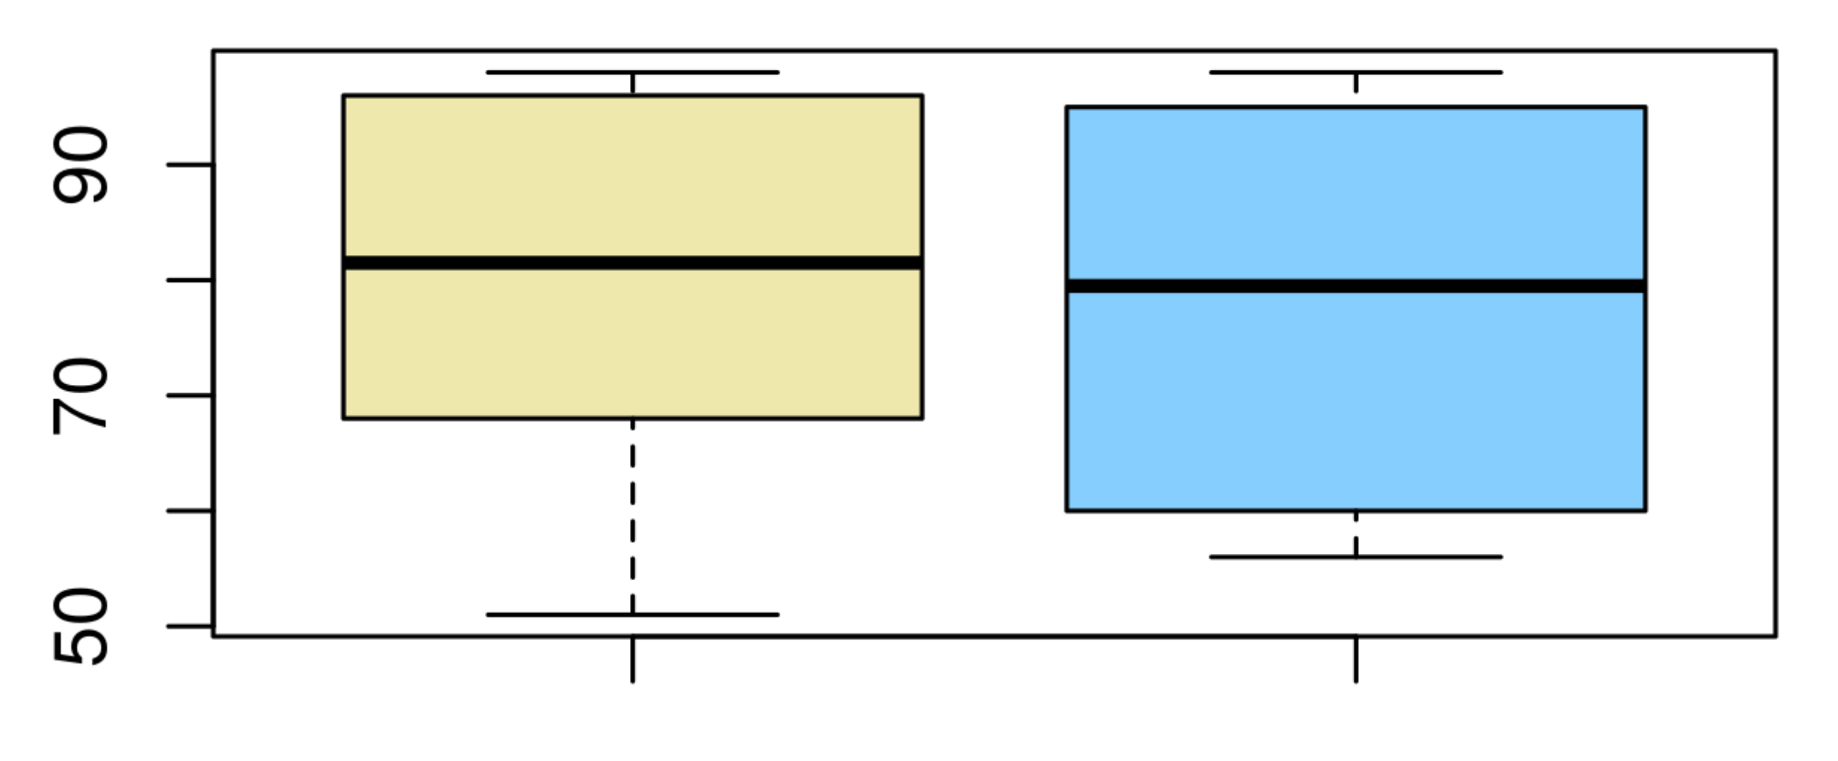
Responses

Slide 24
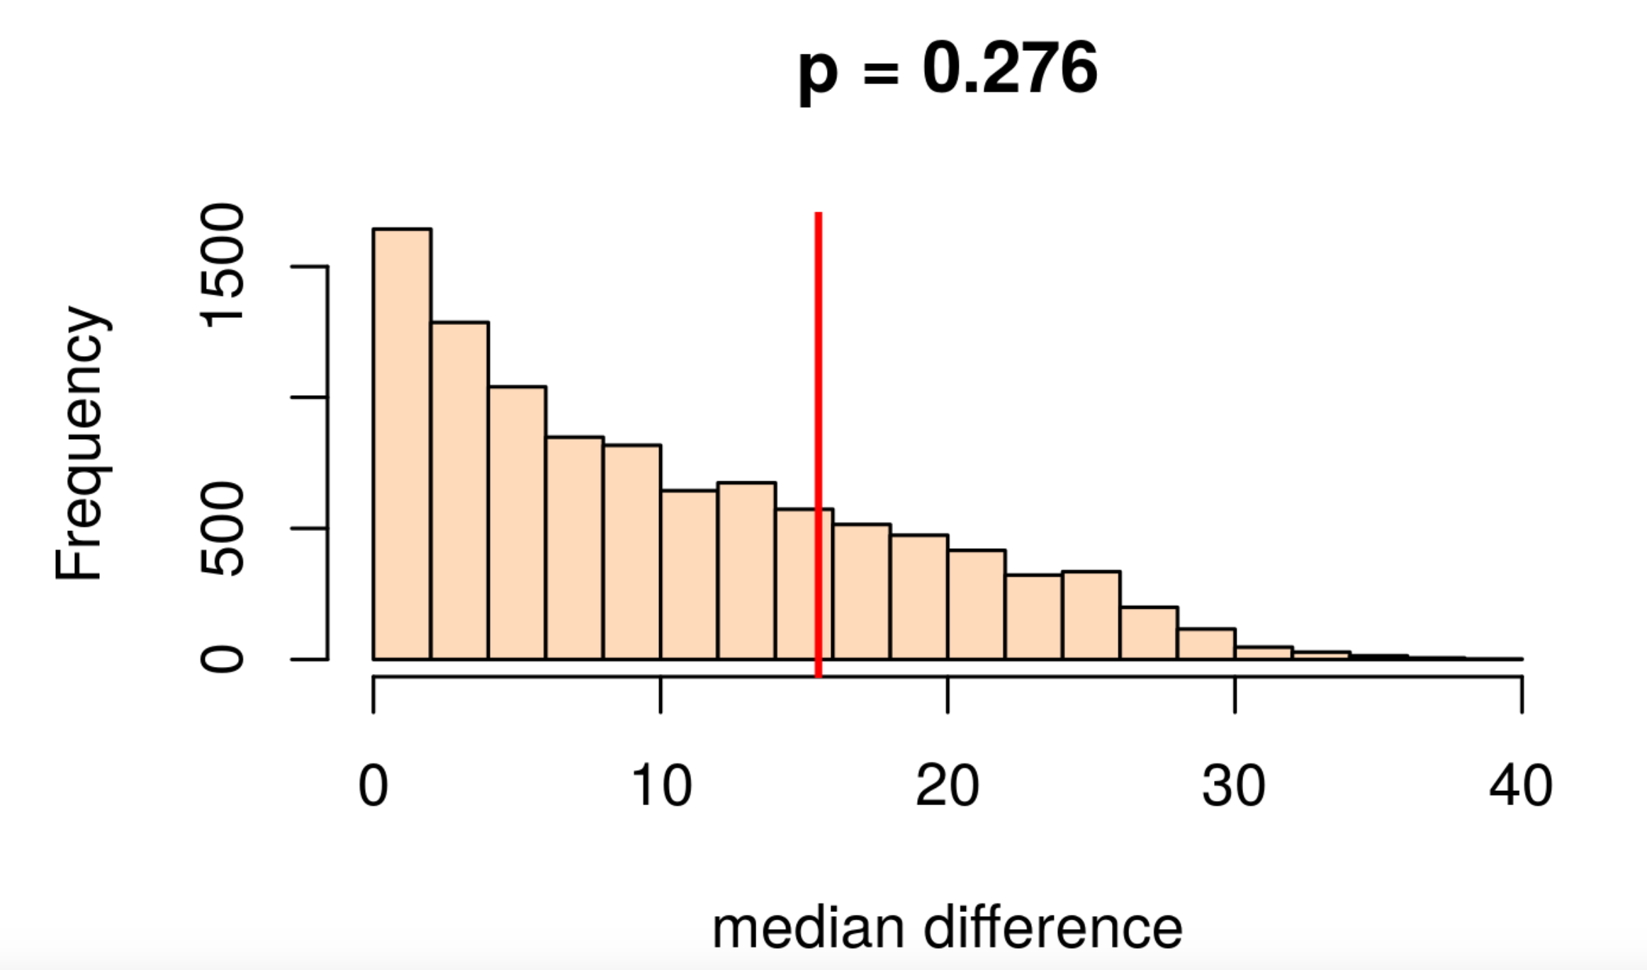
Results

Slide 25
Lecture outline
R function sample
Bootstrapping for hypothesis testing
Bootstrapping to generate confidence intervals
Reflection on bootstrapping

Slide 26
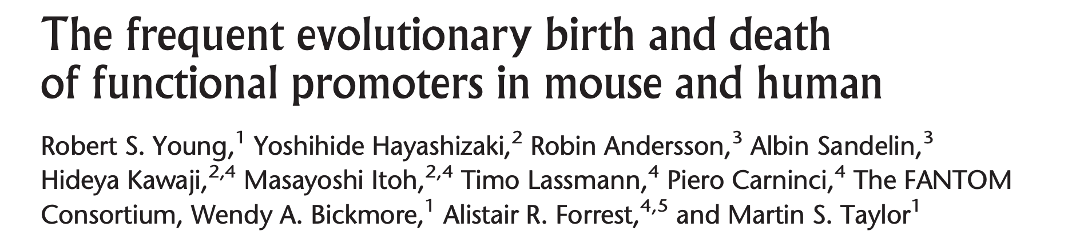
Do the percentage of different types of noncoding and anonymous promoters differ?
Error bars represent the 95% confidence interval of 100 samplings → why with replacement?
Can we reject the H₀?

Slide 27
21/313 noncoding promoters are housekeeping (6.7%).

Slide 28
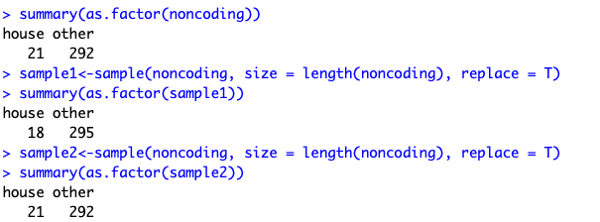
21/313 noncoding promoters are housekeeping (6.7%).

Slide 29
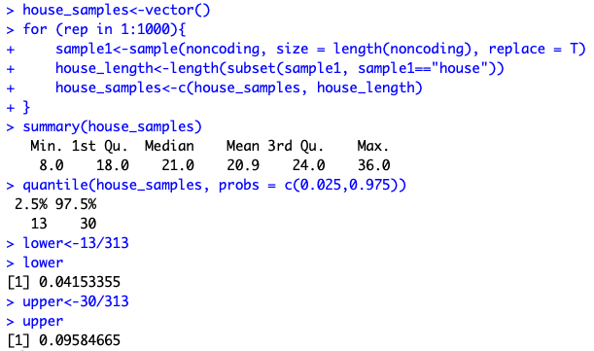
21/313 noncoding promoters are housekeeping (6.7%).

Slide 30
Do the percentage of different types of noncoding and anonymous promoters differ?
Error bars represent the 95% confidence interval of 1,000 samplings → why with replacement?
Can we reject the H₀?

Slide 31
Lecture outline
R function sample
Bootstrapping for hypothesis testing
Bootstrapping to generate confidence intervals
Reflection on bootstrapping

Slide 32
Does bootstrapping make you uncomfortable?
Notes:
Give them a few mins here to talk about. They did not see the next slide

Slide 33
Does bootstrapping make you uncomfortable?
The data we have is incomplete (but it is all we have!)
Fundamentally not an exact method (but does it matter?)

Slide 34
Learning objectives
After this lecture, you should be able to:
Explain the concept of bootstrapping.
Recognise situations where bootstrapping is useful.

Slide 35
Bootstrapping Any questions?
ADS2, Lecture 21
Dr Rob Young – robert.young@ed.ac.uk
Semester 2, 2023/24

